Slide 1
MINI PROJECT
Name | Shashank G Naik Deepak B N Adarsh Prabhakar
Registration Numbers | 231039013 | 231039018 | 231039034
Branch | Embedded Systems
Project Title | To Convert assembly language/machine code to RTL
Guide | Dr. Dinesh Rao B

Slide 2
CONTENTS
Introduction
Literature Review
Objective
Operational Flow
Functional Requirements
Implementation
Work Done
References

Slide 3
INTRODUCTION
Lexical Analysis
Lex is a popular tool used for lexical analysis and text processing in the field of computer science and programming.
It is the first step of compiler design , it takes the input as a stream of characters and gives the
output as tokens also known as tokenization. The tokens can be classified into identifiers,
Separators, Keywords, Operators, Constant and Special Characters.
It has three phases:
Tokenization: It takes the stream of characters and converts it into tokens.
Error Messages: It gives errors related to lexical analysis such as exceeding length, unmatched string, etc.
Eliminate Comments: Eliminates all the spaces, blank spaces, new lines, and indentations.

Slide 4
LITERATURE REVIEW
Nobre, Carolina, et al., "The state of the art in visualizing multivariate networks." - 2019.
This paper provides a comprehensive review of MVN visualization techniques, organized along four axes: layouts, view operations, layout operations, and data operations.
They also discuss the different types of tasks that users can perform with MVN visualizations, such as identifying patterns and trends, comparing different networks, and understanding the relationships between nodes and attributes.
they provide recommendations for choosing the right MVN visualization technique for a given task and discuss the challenges and future directions of MVN visualization research.

Slide 5
LITERATURE REVIEW
2) Ortin, Francisco, at al., "An empirical evaluation of Lex/Yacc and ANTLR parser generation tools.“-(2022)
The authors attributed this to ANTLR's more powerful features and its better integration with the Java programming language.
Also noted that ANTLR is more complex and difficult to learn than Lex/Yacc. This means that it is not always the best choice for developing small and simple parsers.they provide recommendations for choosing the right MVN visualization technique for a given task and discuss the challenges and future directions of MVN visualization research.
Overall, the study provides, valuable insights into the strengths and weaknesses of Lex/Yacc and ANTLR. It can help developers to choose the right parser generation tool for their specific needs.

Slide 6
OBJECTIVE
To Study the Detailed analysis of the Compiler (LEX).
To Convert assembly language/machine code to RTL .

Slide 7
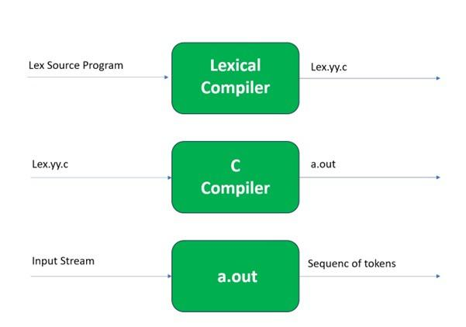
OPERATIONAL FLOW
In the first step the source code which is in the Lex language having the file name ‘File.l’ gives as input to the
Lex Compiler commonly known as Lex to get the output as lex.yy.c.
After that, the output lex.yy.c will be used as input to the C compiler which gives the output in the form of an
‘a.out’ file, and finally, the output file a.out will take the stream of character and generates tokens as output.

Slide 8
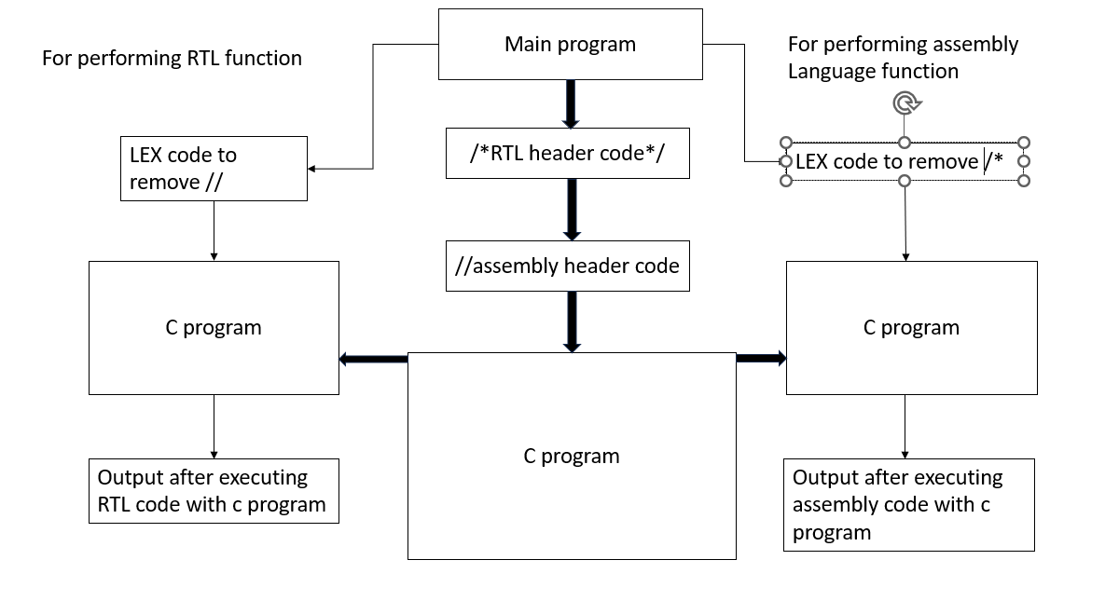
IMPLEMENTATION

Slide 9
IMPLEMENTATION
The main program is written in LEX language.
It is mainly divided into three parts
The first part consists of RTL header code which mainly consists of the RTL code which need to perform the RTL operation and they are enclosed by “/*” operator.
The second part consists of assembly language or the machine language header code which contains the operators which are required to perform the operations and they are enclosed by “//” operator.
The third part mainly consists of the C program which performs the specified operations.
The main moto is to de-comment the commented lines and to perform the C operation which is specified in the third part of the diagram.
First the main code is written in the LEX software and then the compilation of the code is done .
Then an another LEX code is written in a another file which helps to de-comment the commented lines(“/*”,”//”) .

Slide 10
IMPLEMENTATION
The next step is to take the de-commented code as the input parameters for the C program which is written in the main file.
To perform the RTL code we need to de-comment the RTL code header and give the parameters as an input to the C program also removing the parameters which are in the // (assembly language)
Same for the assembly code we need to remove the parameters which are present in the */.

Slide 11
IMPLEMENTATION
%{
#include<stdio.h>
%}
%%
"//".* {fprintf(yyout,"%s",yytext);}
"/*"([^*]|\*+[^*/])*\*+"/" {fprintf(yyout,"%s",yytext);}
.|\n
%%
void main(int argc,char *argcv[])
{
yyin=fopen(argcv[1],"r");
yyout=fopen("out.hex","w");
yyout=fopen("out.v","w");
yylex();
}

Slide 12
IMPLEMENTATION
These are the commands used to execute the lex file
lex file_name.l
cc lex.yy.c –ll
./a.out input_file.c
#include<stdio.h>
int main()
{
printf("creating hex file\n");
//LOAD R0,A
//LOAD R1,B
//ADD R2,R0,R1
//XOR R3,R0,R1
//STORE CARRY,R2
//STORE SUM,R3
printf("created hex file\n\n");
printf("creating rtl file\n");
/*
module halfadder(input wire a,input wire b, input wire sum, input wire carry);
assign carry=a&b;
assign sum=a^b;
endmodule
*/
printf("created rtl file\n");
return 0;
}
Input File

Slide 13
RESULT & DISCUSSIONS
#include<stdio.h>
int main()
{
printf("creating hex file\n");
//LOAD R0,A
//LOAD R1,B
//ADD R2,R0,R1
//XOR R3,R0,R1
//STORE CARRY,R2
//STORE SUM,R3
printf("created hex file\n\n");
printf("creating rtl file\n");
printf("created rtl file\n");
return 0;
}
OUTPUT FILE

Slide 14
WORK DONE
Sl.No | Week​ | Flow of Project​ | Problem Faced​ | Mitigated or not​ | Days taken​
1.​ | Week 1 Week 2 Week 3 Week 4 ​ | ​Selected and explored topic Collected the information about the topic Exploration and Learning the Specification of LEX Compiler Getting Familiar with Tools of LEX compiler | Lack of resources | ​ Yes | 3​ 3 2 2

Slide 15
2 | Week 5 Week 6 Week 7 Week 8 | Familiarization with the Languages(Machine ,RTL) Implementation of the Simple Programs(Machine,RTL) Worked on Comments of LEX Simple LEX program to remove comments from the C program | Program did not get compiled | Yes | 2 4 4 2

Slide 16
REFERENCES
1)Nobre, Carolina, Miriah Meyer, Marc Streit, and Alexander Lex. "The state of the art in visualizing multivariate networks." In Computer Graphics Forum, vol. 38, no. 3, pp. 807-832. 2019.
2)Ortin, Francisco, Jose Quiroga, Oscar Rodriguez-Prieto, and Miguel Garcia. "An empirical evaluation of Lex/Yacc and ANTLR parser generation tools." Plos one 17, no. 3 (2022): e0264326.

Slide 17
THANK YOU

